Slide 1

5 Domains of Writing

Slide 2
Content
The presence of ideas developed through facts;
examples, anecdotes, details, opinions, statistics, reasons, and/or explanations

Slide 3
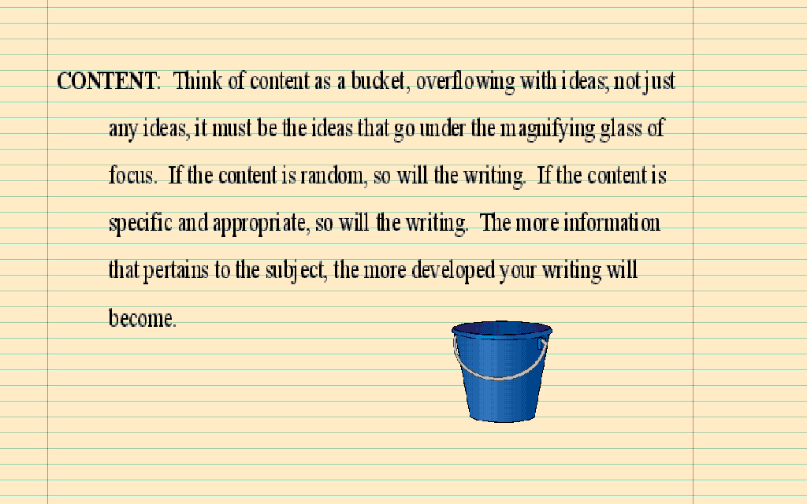

Slide 4
Strong Content
In order to write with strong content a writer must provide substantial, specific; and/or illustrative content demonstrating strong
development and sophisticated ideas

Slide 5
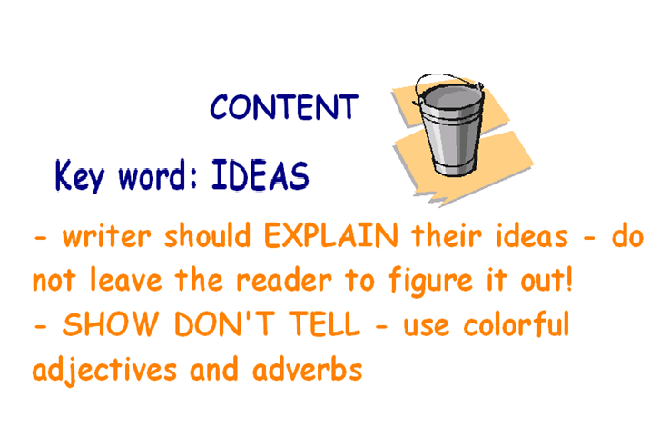

Slide 6
Show Don’t Tell
One of the most important skills of a writer is the ability to SHOW how a character is feeling without TELLING the reader.
Without saying, “He was mad,” you can effectively tell the reader about his anger by focusing on how he looks, what he’s doing, what he’s saying, and how he’s saying it.

Slide 7
Here is an example of telling:
Fern was in the kitchen when she saw her father go by with an ax. She wondered what he was doing with it. Her mother told her he was going to do away with a pig that had been born too small. Fern was upset because she didn’t think a pig should be killed just because it was smaller than other pigs.

Slide 8
Here is an example of showing
“Where’s Papa going with that ax?” said Fern to her mother as they were setting the table for breakfast.
“Out to the hoghouse,” replied Mrs. Arable. “Some pigs were born last night.”
“I don’t know why he needs an ax,” continued Fern, who was only eight.
“Well,” said her mother, “one of the pigs is very small and weak, and it will never amount to anything. So your father has decided to do away with it.”
“Do away with it?” shrieked Fern. “You mean kill it? Just because it’s smaller than the others?”

Slide 9
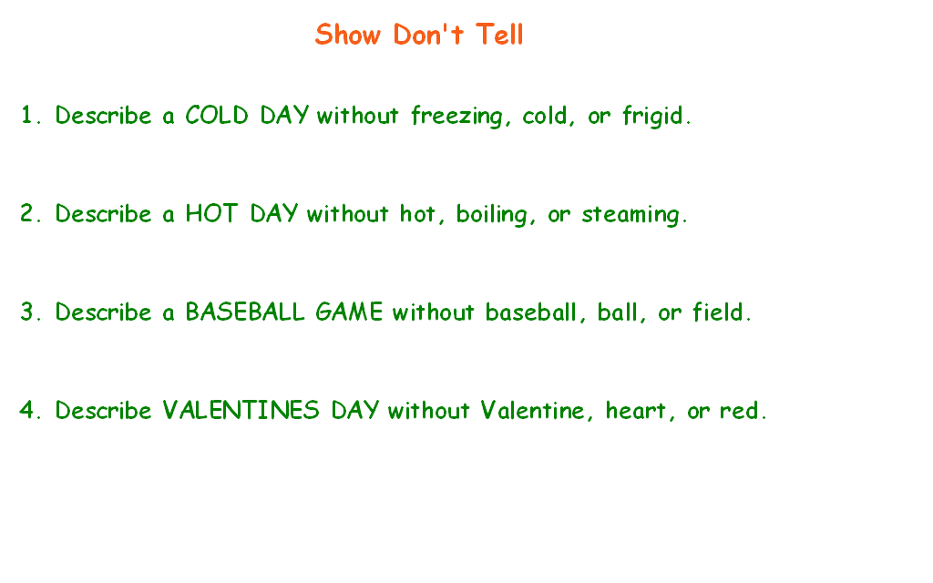
The arctic wind nearly blew Monica over as she pushed her way outside. She pulled her hat down further to cover her ears while narrowly avoiding a slushy puddle.

Slide 10
Using Strong Nouns and Verbs
The CONTENT of your writing will be better when you use COLORFUL adjectives and adverbs.
Example:
“She took an Advil with a tall cool glass of water. Her head had been pounding for over an hour and she still had another two hours of work at Chuck E Cheese.”

Slide 11
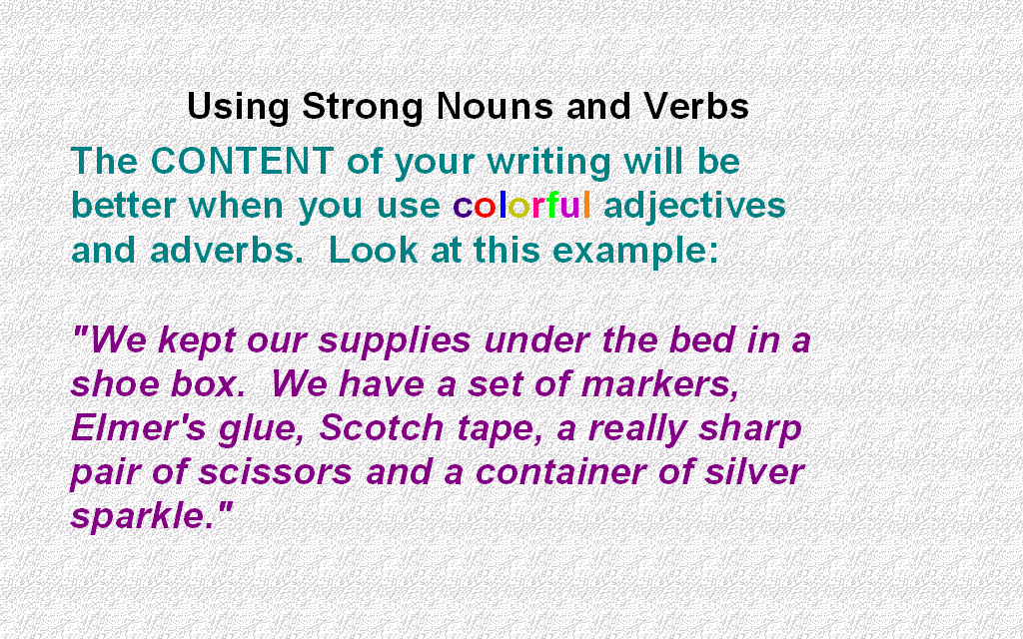

Slide 12
Your turn!
Write an exact noun for each of these common nouns:
Flower
Noise
Bird
Store
Holiday
Building
Meat
Car
Candy
Dog
House
Room

Slide 13
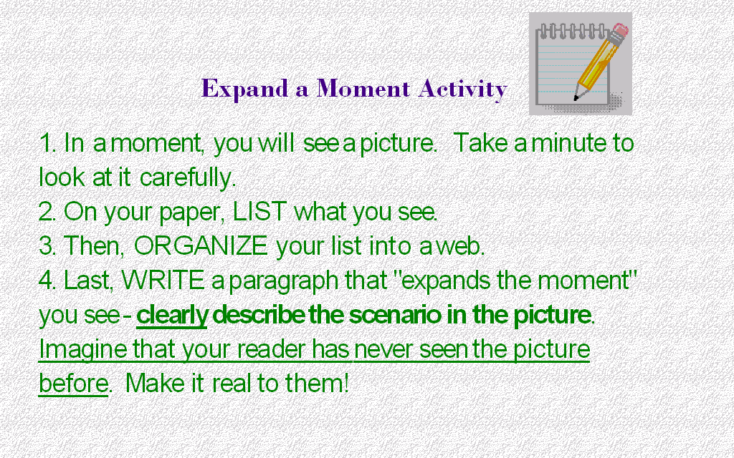

Slide 14
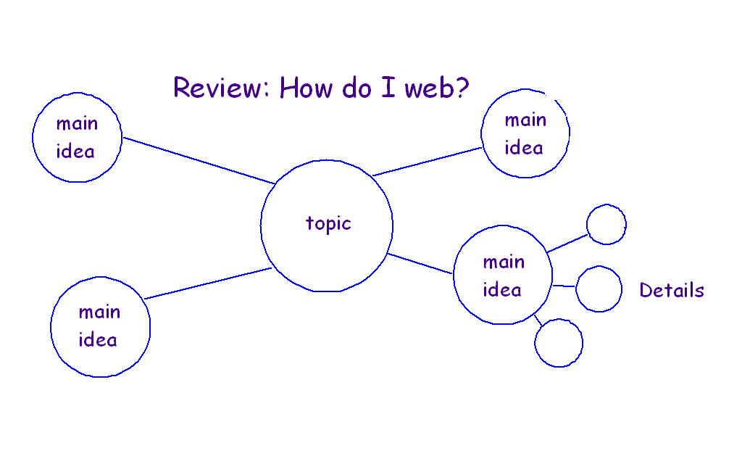

Slide 15
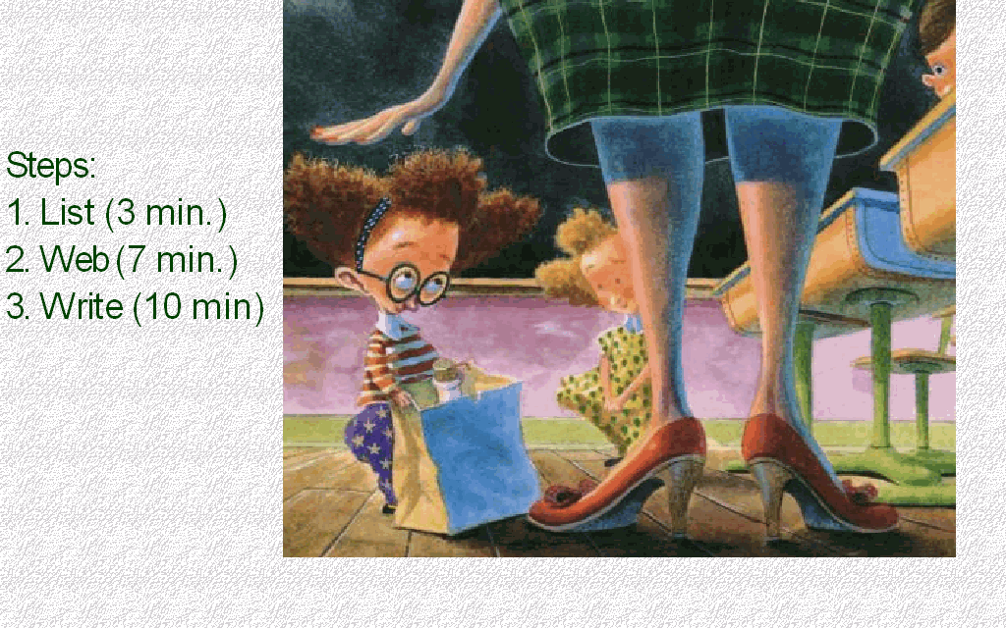

Slide 16
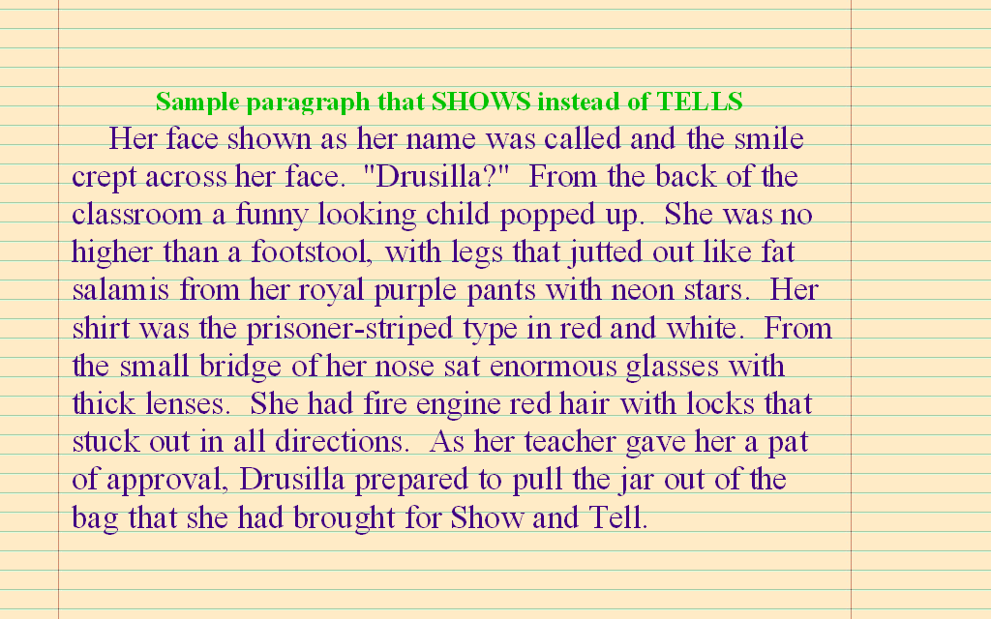

Slide 17
Can you answer today’s EQ?
What does it mean to write for content?

